Slide 1
Airbnb San Diego Market Business Case Development
Team 1:
Qiyuan Peng, Di Hu, Xin Xu,
Qinyu Wei, Munish Khurana

Slide 2
Kaggle Model
Filled all null values for numeric values using aggregation function and simple calculation. Break down meaningful Text variables into keywords, Calculate ratio for making more sense.
Variables:
Original variables: price, monthly/weekly price, availabilities, number of beds, bedrooms, bathroom, guest_included, host listings, review scores, extra people fee, cleaning fee, deposit, min/max nights, host_identity_verified, host_is_superhost, etc.
Derived variables:
Extracted From text: length of text variables,
keywords from amenities,host verifications,
descriptions, cancellation policies,
Sentiment results for neigborhood overviews
Ratio:
bathroom/bedrooms, beds/bedrooms,
price/bedrooms,price/weekly_price,
extra_people/price, cleaning fee/price
AUC: 0.948 based on 30% of the test data
trctrl <- trainControl( method = "cv", number = 10, classProbs = TRUE,
verboseIter = TRUE, summaryFunction = prSummary, savePredictions = TRUE, allowParallel = TRUE)
tune_grid <- expand.grid( nrounds = 300, max_depth = 10, eta = 0.05, gamma = 0.01, colsample_bytree = 0.75, min_child_weight = 0, subsample = 0.6)
xgb_fit <- train(as.factor(high_booking_rate) ~., data = trainx, method = "xgbTree",
trControl=trctrl,
metric = "AUC",
tuneGrid = tune_grid,
tuneLength = 10)

Slide 3
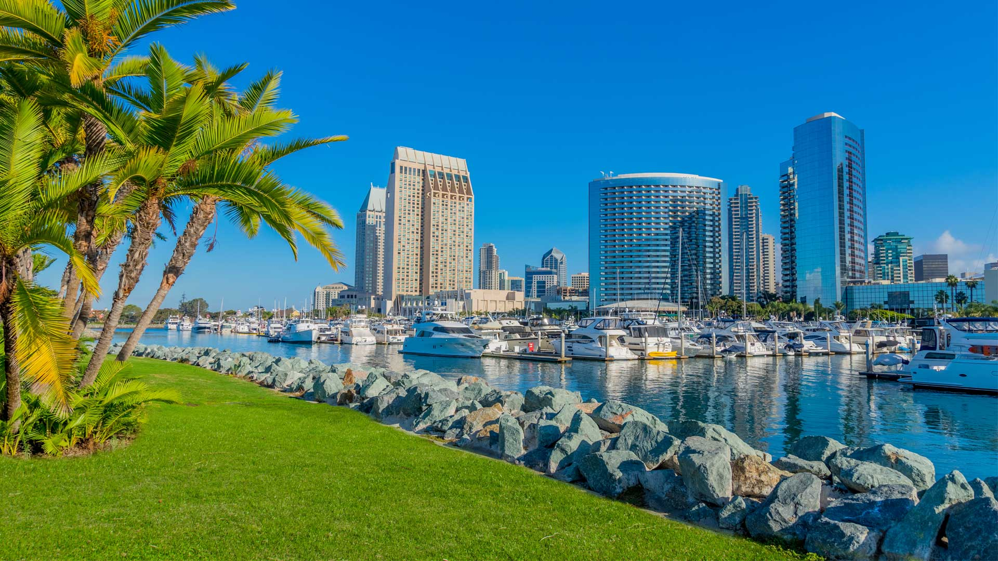
Introduction
San Diego was the second most popular California destination for Airbnb users last year, bringing hosts $213 million in income.
Most of the customers of Airbnb are coming for vacation in San Diego
Our perspective is focusing on the initial acquisition of the home.
To discover market characteristics and provide critical insights for investors.
Notes:
San Diego was the second most popular California destination for Airbnb users last year, bringing hosts $213 million in income. Most of the customers of Airbnb are coming for vacation in San Diego. Our perspective is focusing on the initial acquisition of the home. To discover and understand which impact of market characteristics such as seasonality, events, attractions, etc and house characteristics such as house type, amenity, room, etc, will be the critical insights for investors.

Slide 4

Research Questions & Expected Findings
Preliminary questions related to our perspective:
Where is the best location to own a Airbnb house in San Diego?
What kind of house?
What amenities/features may help to make it popular?
Notes:
Find out the Top x features of those homes with good reviews and high book rates to see what features matter in the San Diego market.
Which location has relatively high demand? Are those locations near hot tourist sites?
Which neighborhood is crowded with Airbnb hosts in certain areas(locations)?
Which location/neighborhoods has high review scores? Which aspects of the review matter most in the San Diego market? Is it related to the booking rate of that location?
Are the average prices in those locations or neighborhoods higher than other places?by what percentage? Consider both location feature and the seasonality feature, which has a stronger impact?
How many beds/bathrooms should we include in our house to make it more popular in certain locations?
What feature can make an airbnb room become more popular in San Diego? (Like BBQ equipment and swimming pool or Sea view balcony), Does having a kitchen relate to a high booking rate?
Which house type/ decoration style is more popular?

Slide 5
Location Selection
Step 1: Find the location
Step 2: FIlter the top neighborhood
Step 3: Conprehensive Analyis of top neighborhood
Step 4: Choose the optimal/recommended site

Slide 6
How we decide?
By using zipcode as our index, we grouped all Airbnb houses within certain locations, and calculated the proportion of houses that have high booking rate in each location to help us determine whether a location is popular among Airbnb users, and then we sorted Top 10 locations.
Top 10 locations helped us to find several popular areas in San Diego. Then, we visualized the neighbourhoods within these areas on map.
With the help of data visualization and business researches we have conducted, we found two big areas as the guideline for us to find our expected neighbourhood.
Notes:
To find the best location, we decided to start with the zip code. We ranked the zip code from high to low according to the high booking rate (number of high booking rates (1) in that zip code divided by the total number of rents). We found that the top 10 zip code is 92104, 92102, 92116, 92107, 92121, 92113, 92105, 92114, 92110, and 92106. To discover the relationship of those zipcode(location) and the reason behind it, we conduct some research via local websites, tour guides, yelp review, and google maps.

Slide 7
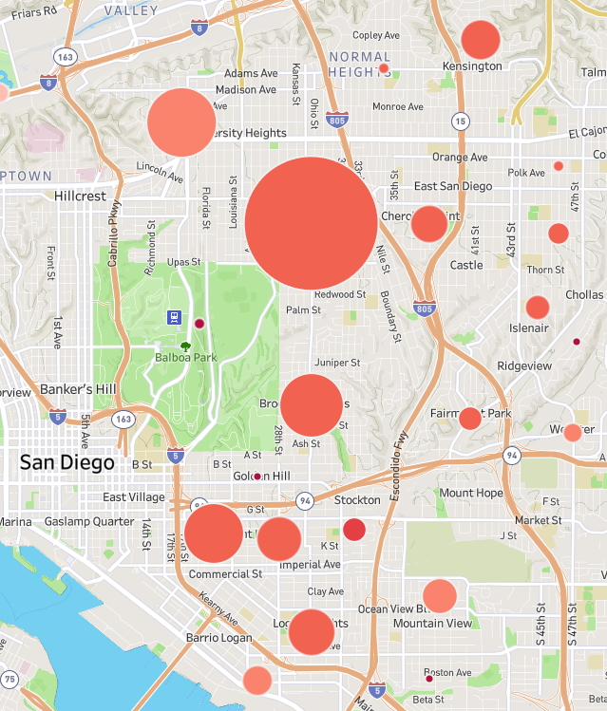
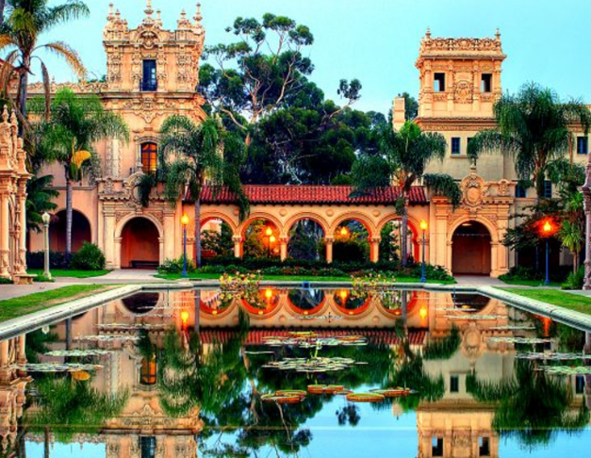
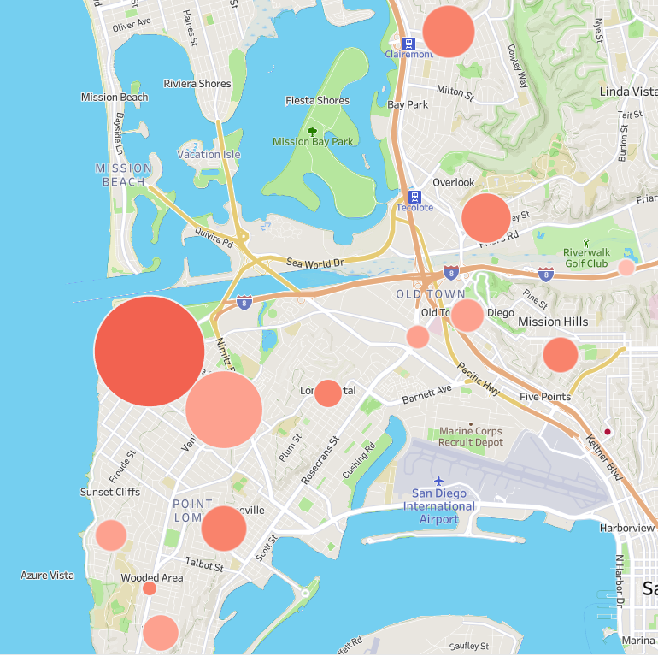
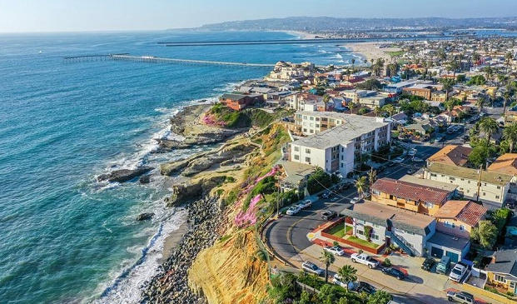
Results & Findings
Two Main Areas
Balboa Park Area
Ocean Beach & UCSD Area
Notes:
After data visualization and analysis, we found that those zip codes with relatively higher booking rates can be grouped into two main areas: “Balboa Park Area” and “Ocean Beach Area”. “Balboa Park Area” is an area centered on Balboa Park. ”Ocean Beach Area” is an area located on the upper bay of San Diego Bay.
The wonderful Balboa Park is definitely the best attraction in San Diego and it includes a lot of different places to have fun such as San Diego Art & Space Museum, San Diego Zoo, and Japanese friendship garden. The house at or near Balboa park will never worry about booking. It reminds me of the Mammoth Hot Springs Hotel & Cabins at YellowStone Park. People even need to book it one year in advance because it is rare that a hotel is located at the YellowStone.

Slide 8
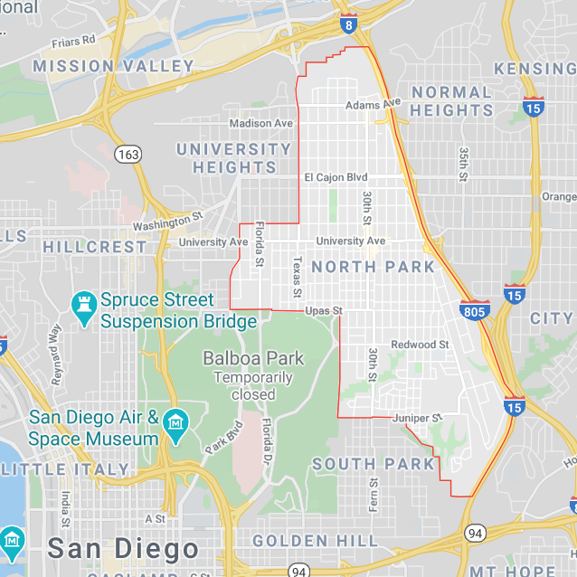
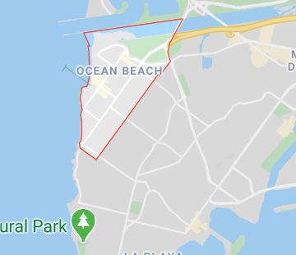
Site Selection Summary
Balboa Park Area: North Park
On the southwest of Balboa Park
Convenient transportation, many restaurants and supermarkets.
Close to attractions and downtown.
often considered to be the heart of the neighborhood
Ocean Beach & UCSD Area: Ocean Beach
Located about 7 miles (11 km) northwest of Downtown San Diego
Ocean Beach lies on the Pacific Ocean at the estuary of the San Diego River.
Beautiful beach town and historic business district. With attractions, restaurants, sunsets, shops, events,and fun.
Notes:
Although some specific airbnb such as a house in Balboa Park, has a 100% booking rate, we are going to choose some place with relatively higher supply. Finally, we choose North park which is a place located in the northeast of Balboa Park. It is in a quiet residential area. This residential areas are close to attractions. North Park have convenient transportation, restaurants, and supermarkets, etc. North Park is more closer to Downtown of San Diego than Ocean Beach which is potentially attract different group of people from various areas. It’s also only 15 mins drive to Ocean Beach. The market is mature and has large supply. The professional housing management company is near by. We need more selections to choose the competitive house types and features.

Slide 9
Features Finding
Step 1: Keywords Abstraction
Step 2: New Dummy Variables Creation
Step 3: Data Visualization
Step 4: Learn from the results

Slide 10
How we decide?
After exploring our data, we found some text columns like Amenities, Descriptions may include useful features such as Kitchen, Sea view, Dog friendly and so on.
Therefore, we abstracted those keywords and created dummy variables to see whether it can contribute to getting a high booking rate.
After getting those features, we calculated the proportion of houses that have high booking rate with those amenities and compare the proportion of high booking rate for all data.

Slide 11
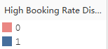
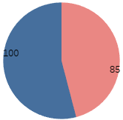
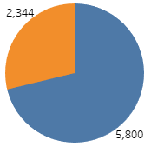
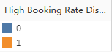
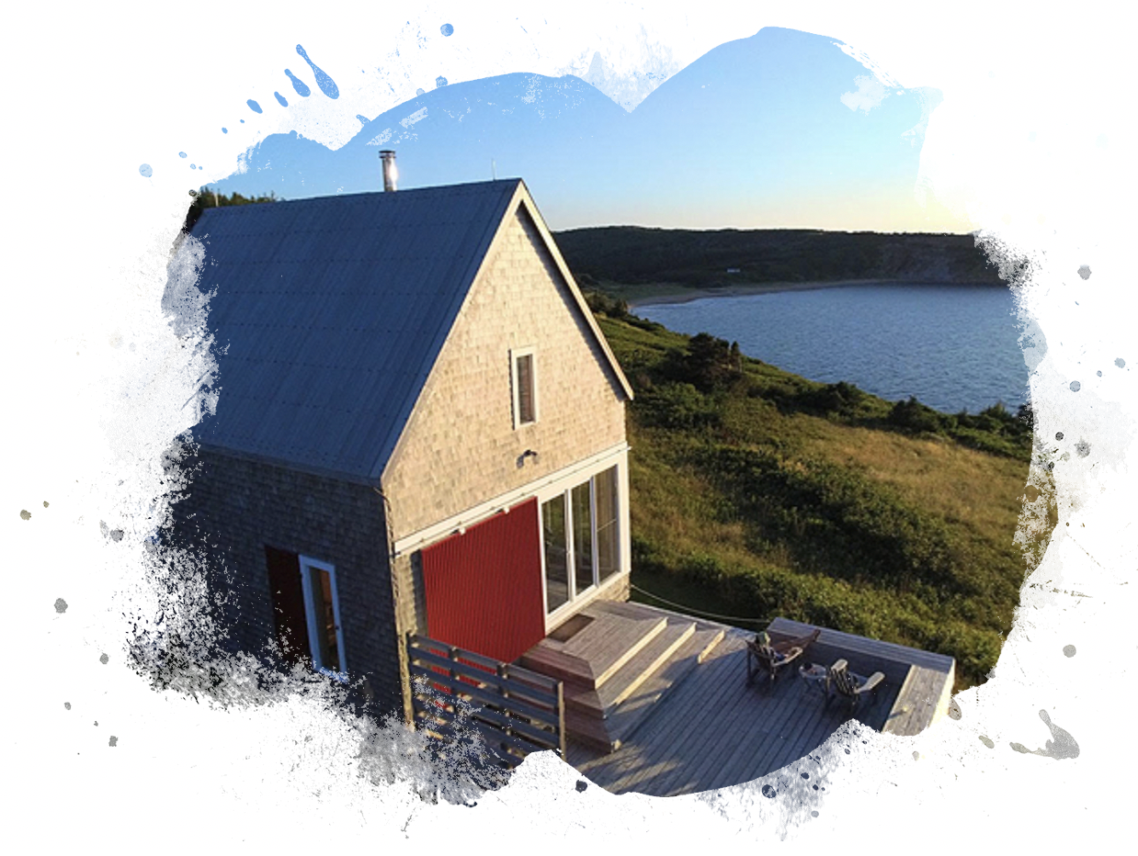
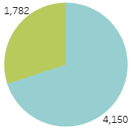
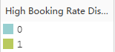
What house?
A small simple house, typically one near a lake or beach.
Notes:
最前面两个，没什么参考价值，主要可以说第4个和第五个，Loma Portal 和 Ocean Beach, 毕竟Ocean Beach 房源多

Slide 12
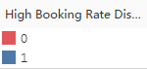
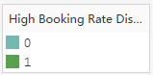
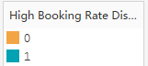
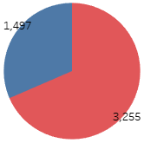
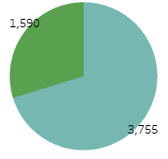
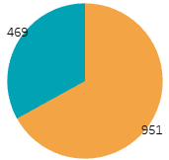
How many rooms or beds?
Notes:
最前面两个，没什么参考价值，主要可以说第4个和第五个，Loma Portal 和 Ocean Beach, 毕竟Ocean Beach 房源多

Slide 13
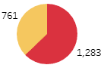
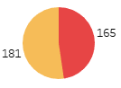
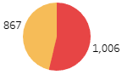
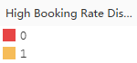
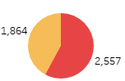
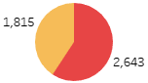
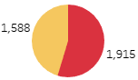
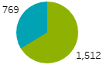
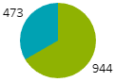
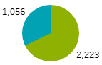
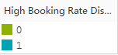
Amenities

Slide 14
Accomendation
Location: Ocean Beach & UCSD Area, Ocean Beach(Host Neiborhood)
Room features: 1B1B with 2 beds
Property Type: Cottage
Room Type: Entire home/apt
Description: Sea, Water View, Beach, Restaurants, Downtown, Bars
Amenity: Wifi, Air Conditioning, Kitchen, Free Parking, Heating, Washer, Drier, Smoke Free, Carbon, Essentials, Shampoo, Lock, Hanger, Hair Drier, Iron, Laptop, Private, TV, Internet, Kid Friendly, Safety card, Pet Friendly, Dog Friendly, Water View, Microwave, Coffee, Dishes, Selfcheckin, Hottub, Oven, Stove, Barbecue
Host verification: Email, Phone, Facebook, Google, Online/Offline
Cancellation Policy: Flexible
Notes:
After features analysis and selection, the final location will be the Ocean Beach area because it has the sea view, beach, and more restaurants and bars nearby. The optimal house type is a cottage with 1B1B and 2 beds. We want to find a site that has a sea view, near the beach, restaurants, downtown, and bars. The customer will willing to book an Airbnb with an Internet connection, Wifi, Laptop, AC, smoke allowed, Kitchen (where it has a washer, microwave, coffee, dishes, oven, stove, and BBQ), some essentials such as shampoo, hairdryer, the lotion also should be contained in the bathroom as well as the hot tub. Since most people in the US have dogs, they want an Airbnb which is pet friendly. The room should be good in security and privacy. Therefore, an intelligent lock that could be used in self-Check In is necessary. People don’t want to book an Airbnb with Strict Cancellation Policy. They want the Host to have an email, phone, google, and Facebook verification to make sure the host is a nice guy.
If all these requirements are achieved, I believe you will be a successful investor in Airbnb.

Slide 15
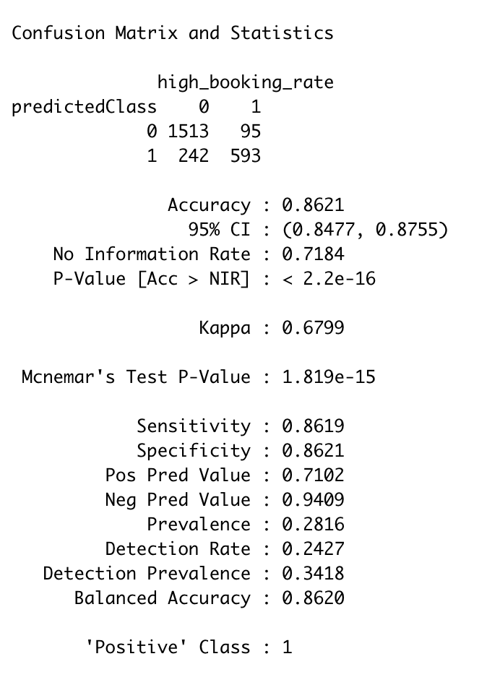
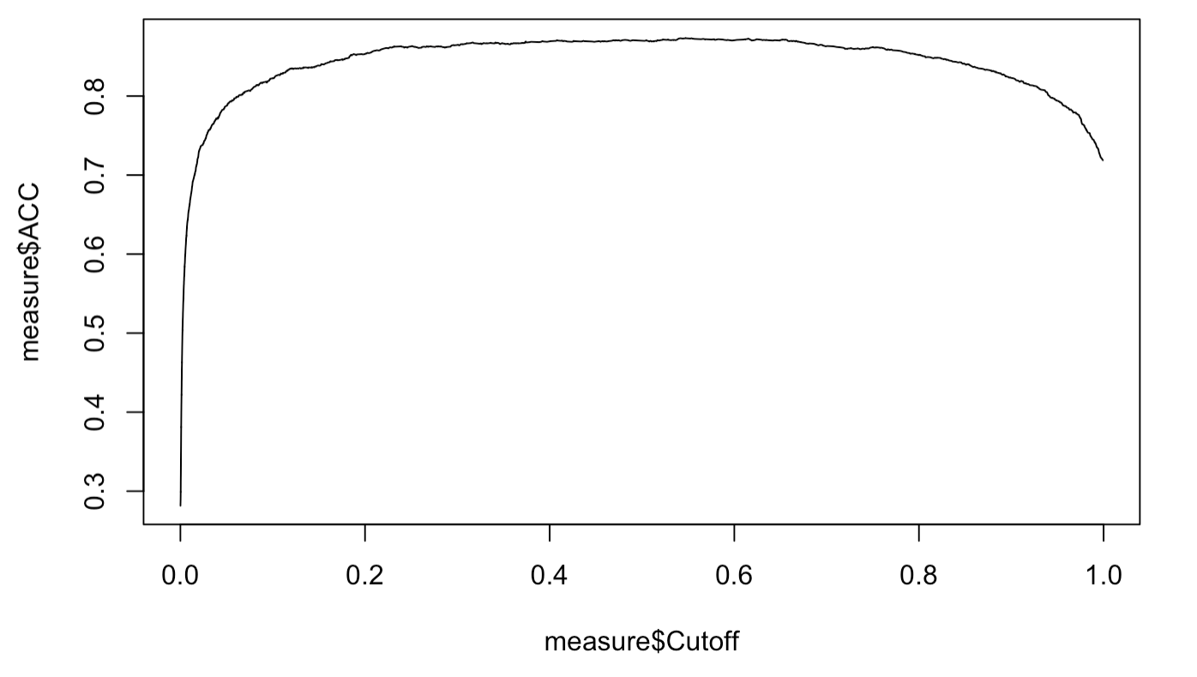
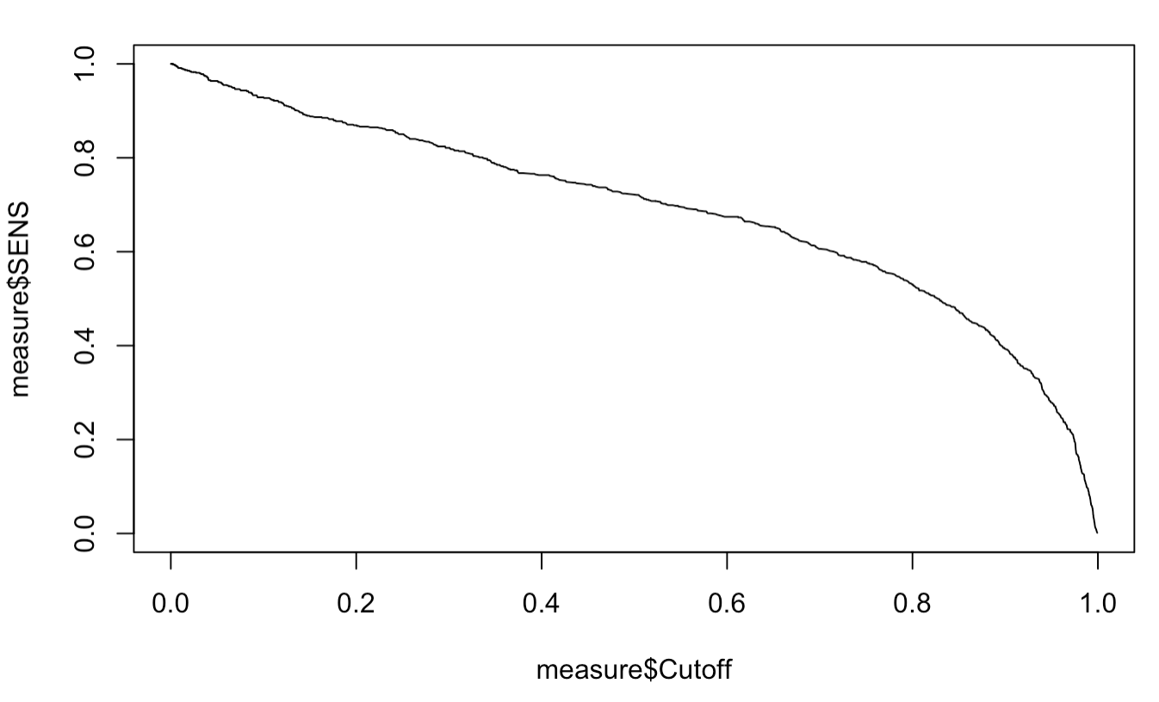
Verify our recommendation
---choosing a cutoff
cutoff=0.23
Notes:
After features analysis and selection, the final location will be the Ocean Beach area because it has the sea view, beach, and more restaurants and bars nearby. The optimal house type is a cottage with 1B1B and 2 beds. We want to find a site that has a sea view, near the beach, restaurants, downtown, and bars. The customer will willing to book an Airbnb with an Internet connection, Wifi, Laptop, AC, smoke allowed, Kitchen (where it has a washer, microwave, coffee, dishes, oven, stove, and BBQ), some essentials such as shampoo, hairdryer, the lotion also should be contained in the bathroom as well as the hot tub. Since most people in the US have dogs, they want an Airbnb which is pet friendly. The room should be good in security and privacy. Therefore, an intelligent lock that could be used in self-Check In is necessary. People don’t want to book an Airbnb with Strict Cancellation Policy. They want the Host to have an email, phone, google, and Facebook verification to make sure the host is a nice guy.
If all these requirements are achieved, I believe you will be a successful investor in Airbnb.

Slide 16
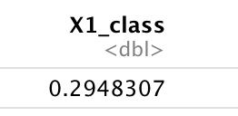
Verify our recommendation
---test it
Becoming and Maintaining SuperHost
Host a minimum of 10 stays in a year.
Respond to guests quickly and maintain a 90% response rate or higher.
Have at least 80% 5-star reviews.
Honor confirmed reservations (meaning hosts should rarely cancel).
host_is_superhost
host_verifications_review
host_identity_verified
Make it be!
https://www.airdna.co/blog/airbnb_superhost_status
Notes:
After features analysis and selection, the final location will be the Ocean Beach area because it has the sea view, beach, and more restaurants and bars nearby. The optimal house type is a cottage with 1B1B and 2 beds. We want to find a site that has a sea view, near the beach, restaurants, downtown, and bars. The customer will willing to book an Airbnb with an Internet connection, Wifi, Laptop, AC, smoke allowed, Kitchen (where it has a washer, microwave, coffee, dishes, oven, stove, and BBQ), some essentials such as shampoo, hairdryer, the lotion also should be contained in the bathroom as well as the hot tub. Since most people in the US have dogs, they want an Airbnb which is pet friendly. The room should be good in security and privacy. Therefore, an intelligent lock that could be used in self-Check In is necessary. People don’t want to book an Airbnb with Strict Cancellation Policy. They want the Host to have an email, phone, google, and Facebook verification to make sure the host is a nice guy.
If all these requirements are achieved, I believe you will be a successful investor in Airbnb.

Slide 17
Thank you for listening!
Team 1:
Qiyuan Peng, Di Hu, Xin Xu,
Qinyu Wei, Munish Khurana

